Slide 1

CSS5120:Computational Linguistics
Zhanzhan Zhao 赵展展 (Instructor)
Assistant professor,
Division of Computational Social Science / Development and Governance
School of Humanities and Social Science
Nianci Zhao 赵念慈 (Teaching assistant)
PhD student in Computational Social Science
School of Humanities and Social Science

Slide 2
W1: Introduction to Computational Linguistics and NLP for Social Science
Content:
Overview of computational linguistics and NLP.
Applications in social sciences: sentiment analysis, and LLMs.
Course logistics and expectations.
Activity:
Discuss examples of NLP in social science studies.
Group discussion: Self-intros
Learning Goals:
• Familiarize students with course goals and scope.
• Contextualize NLP for social sciences.

Slide 3
Please stop me anytime when you don’t get what I am saying. In fact, you will get class participation bonus by doing it.
(Professional) Vocabulary that I am familiar with, might not sound familiar to you. But I might just default it to be a commonly used word.

Slide 4
Computational Linguistics, NLP, and LLM
Computational linguistics: Interdisciplinary field combining linguistics and computer science to model and understand human language computationally.
Natural language processing: Subfield of AI focused on enabling computers to process and interpret human language.
LLM: Advanced AI models trained on extensive text data to generate and comprehend human-like language.
Interrelations: CL informs NLP; NLP employs LLMs for advanced tasks.
Notes:
Add

Slide 5
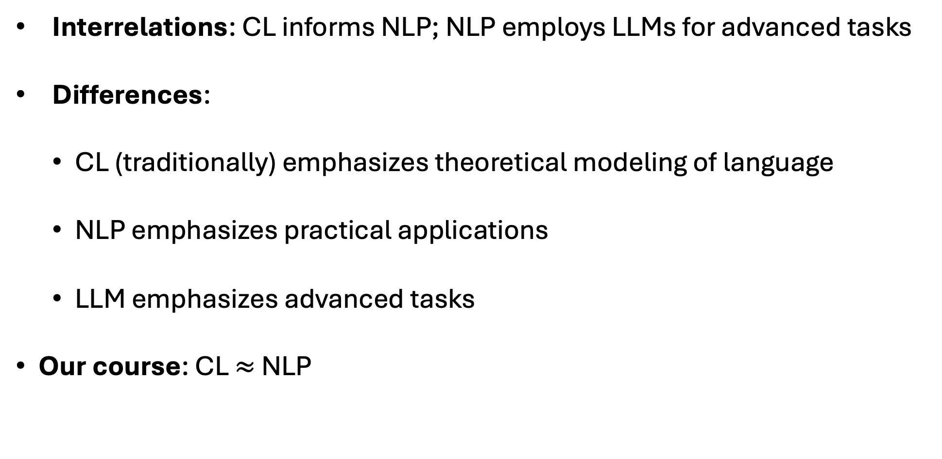
Computational Linguistics, NLP, and LLM
Interrelations: CL informs NLP; NLP employs LLMs for advanced tasks
Differences:
CL (traditionally) emphasizes theoretical modeling of language
NLP emphasizes practical applications
LLM emphasizes advanced tasks
Our course: CL $≈$ NLP
Notes:
Add

Slide 6
Computational Linguistics, NLP, and LLM
These are NOT angles of our course:
We don’t expect you to improve NLP algorithms (SDS)
We don’t expect you to train a better LLM (Benyou Wang, SDS)
Don’t expect me to teach like a linguist (My division is CSS)
Don’t sell yourself this way either
Notes:
Add

Slide 7
Computational Linguistics, NLP, and LLM
The Angle of our course:
NLP applied to social science
Social science’s insight into LLM systems
Studying LLMs like studying humans
Interactions between LLM and society
Notes:
Add

Slide 8
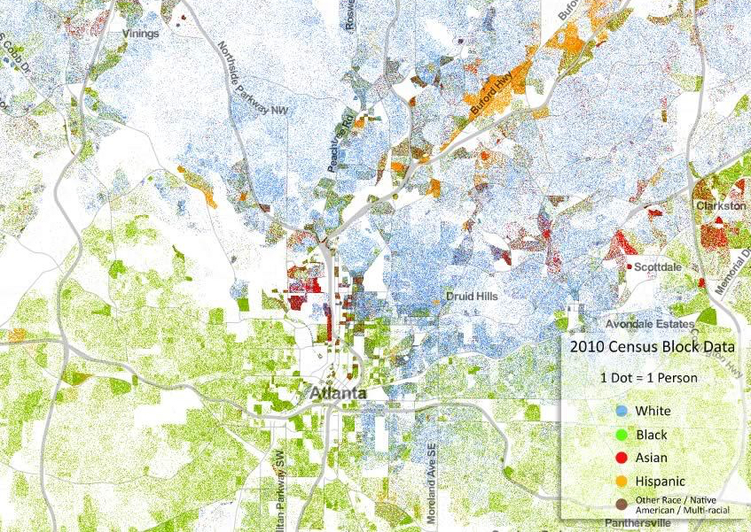
The Angle of our course – NLP applied to social science
Eg.1 Sentiment analysis to measure subjective factors
Segregation
Correlation factors
Objective factors
Income Inequality by race
% Public transportation

Slide 9
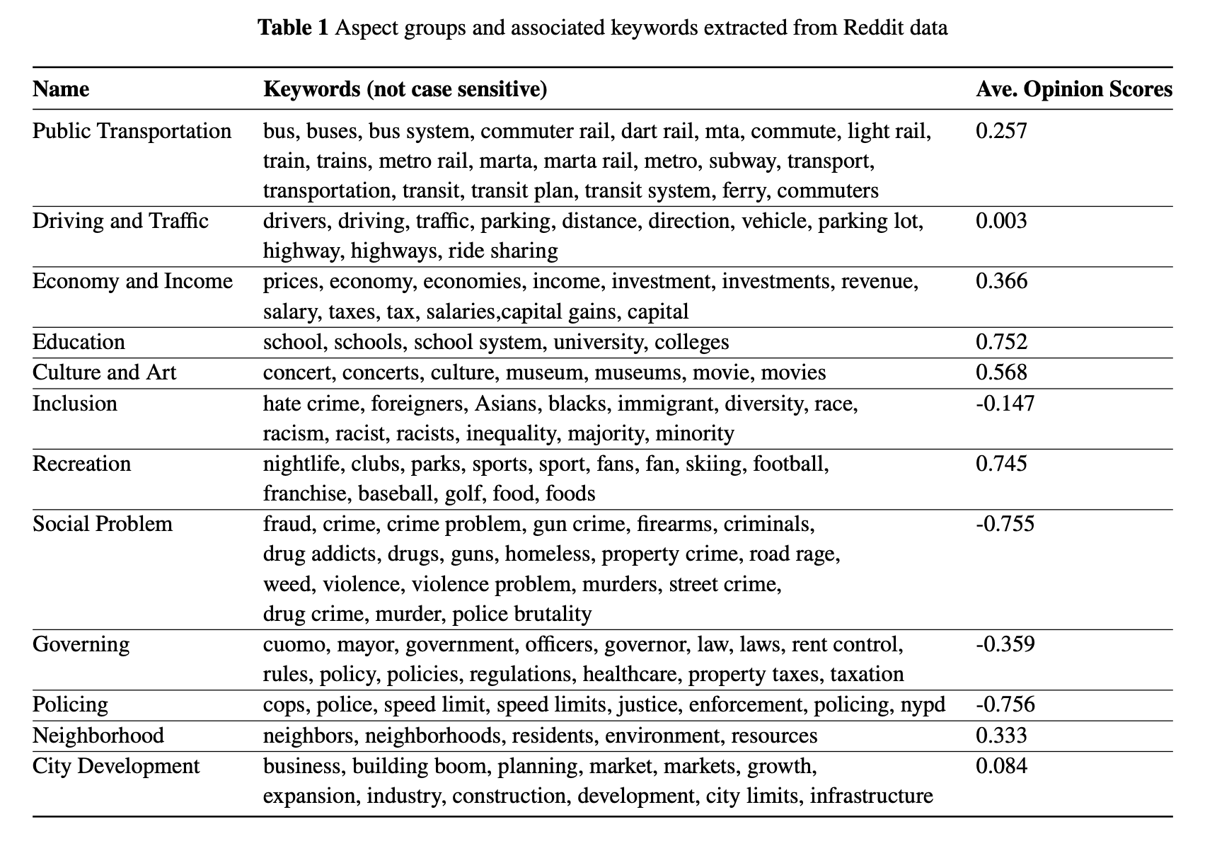
The Angle of our course – NLP applied to social science
Eg.1 Sentiment analysis to measure subjective factors
Source: my working paper
Notes:
Add

Slide 10
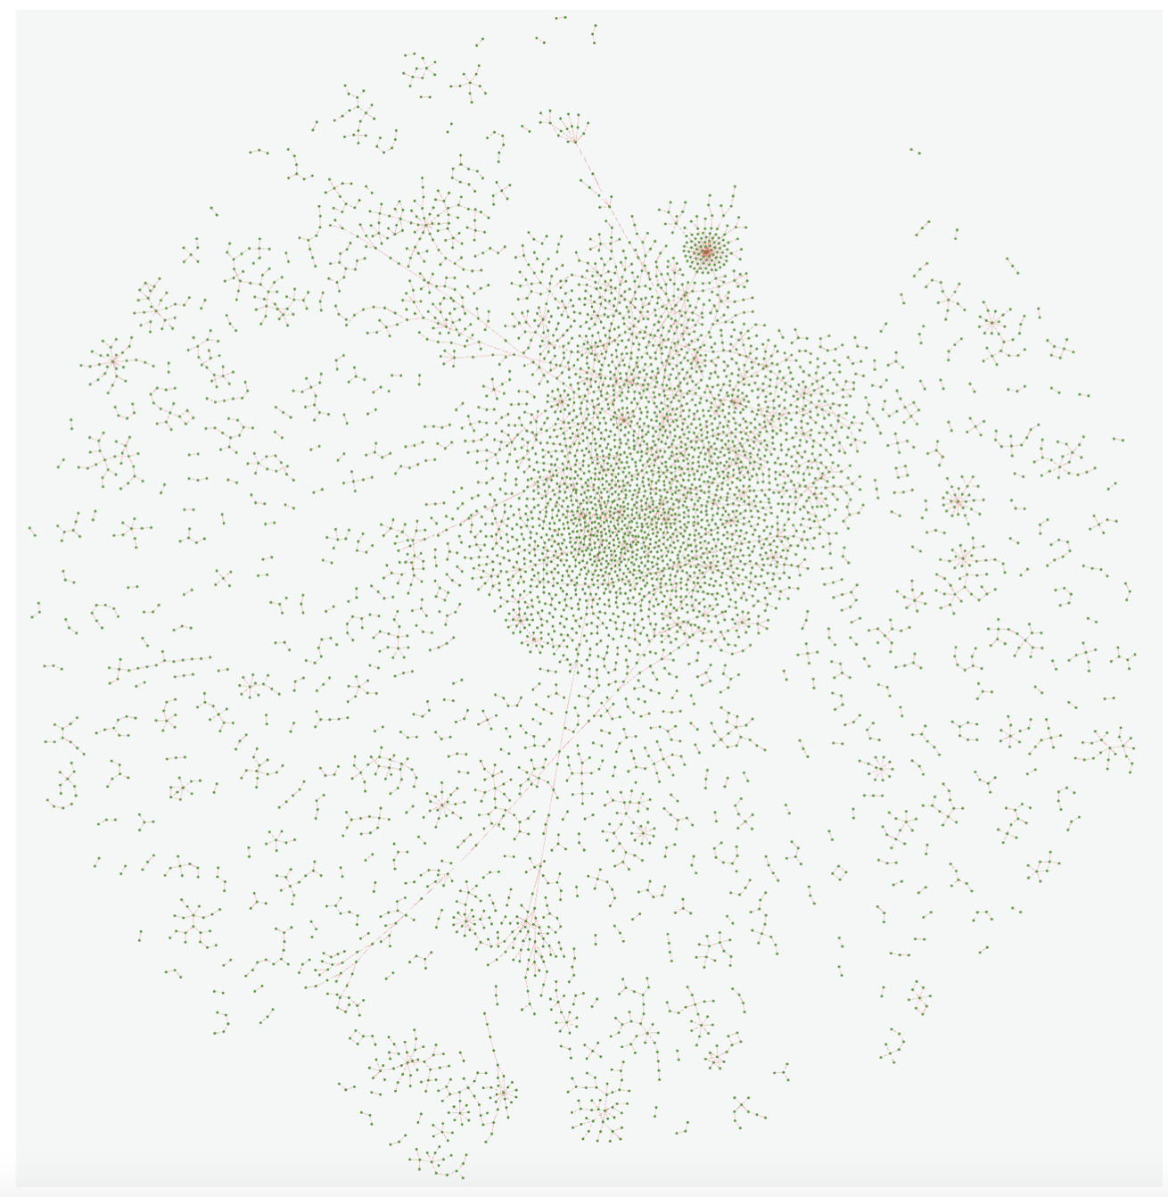
The Angle of our course - NLP applied to social science
Eg.2 LLM agents to model social dynamics
Source: https://oasis.camel-ai.org

Slide 11
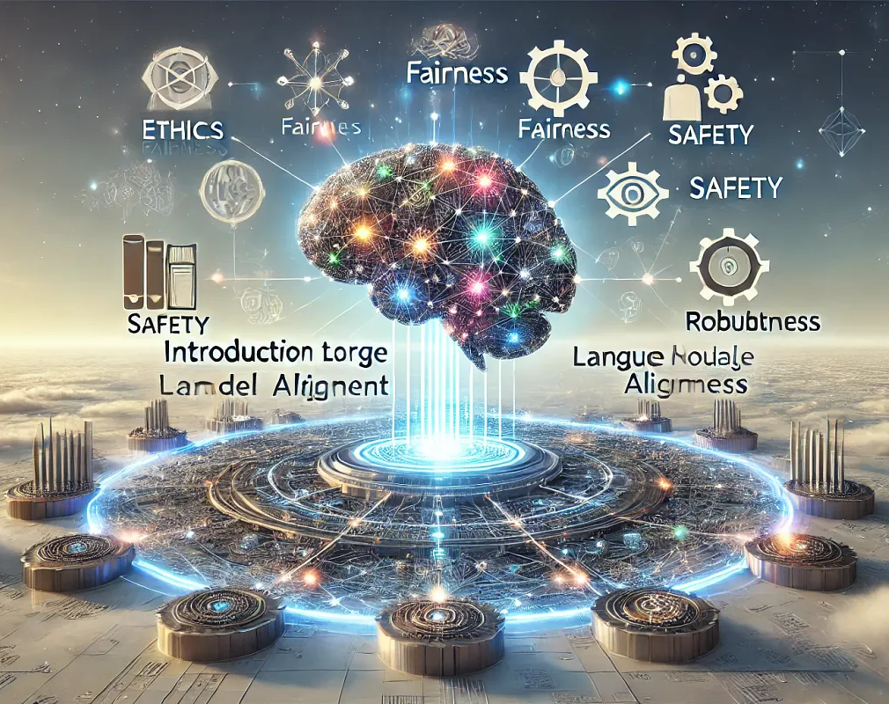
The Angle of our course - Social science’s insight into LLM systems
Eg. 1 LLM value alignment
Notes:
Add

Slide 12
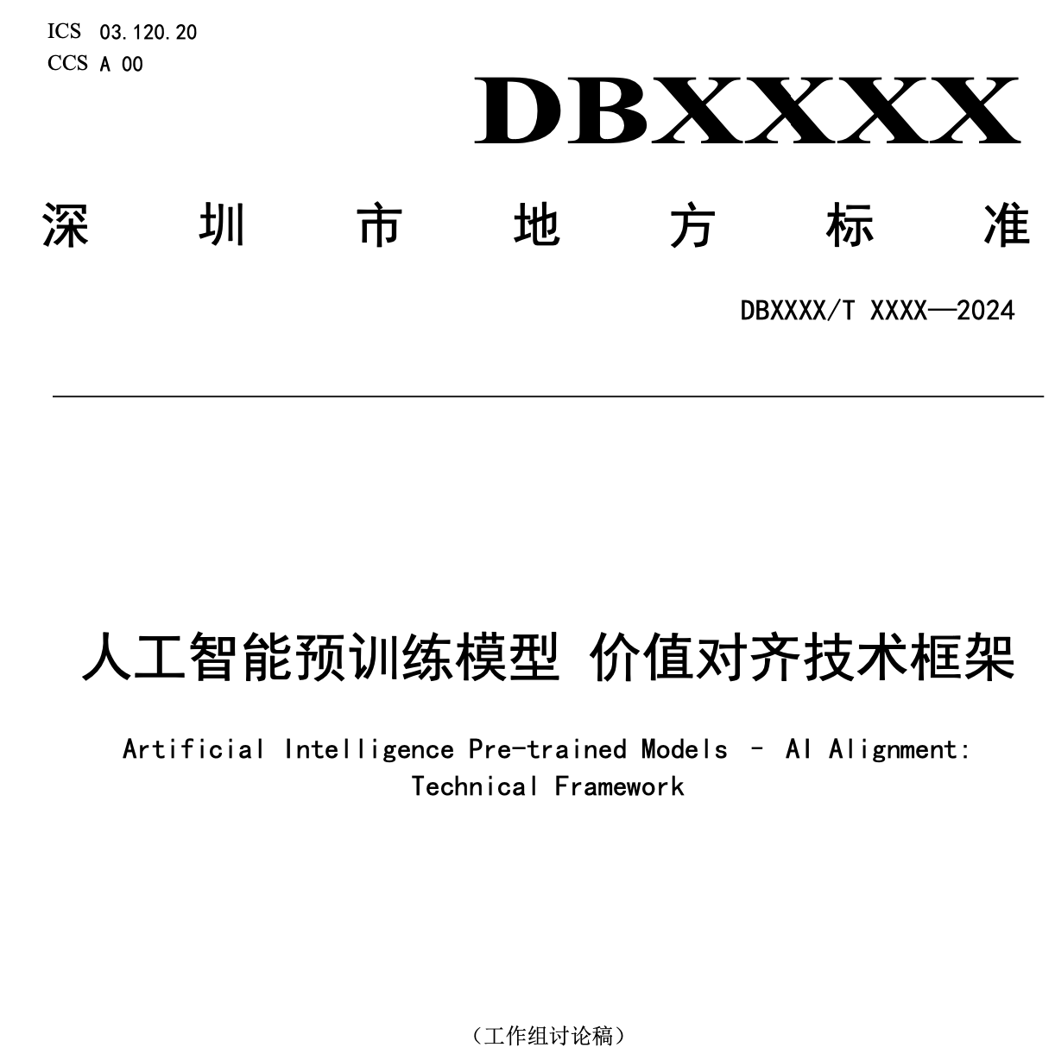
The Angle of our course - Social science’s insight into LLM systems
Eg. 1 LLM value alignment
Quantifying general human value
Controllable
Explainable
Inclusive / Fairness
Quantifying specific human value
Application scenarios
Vulnerable groups
Value evolution
Notes:
Add

Slide 13
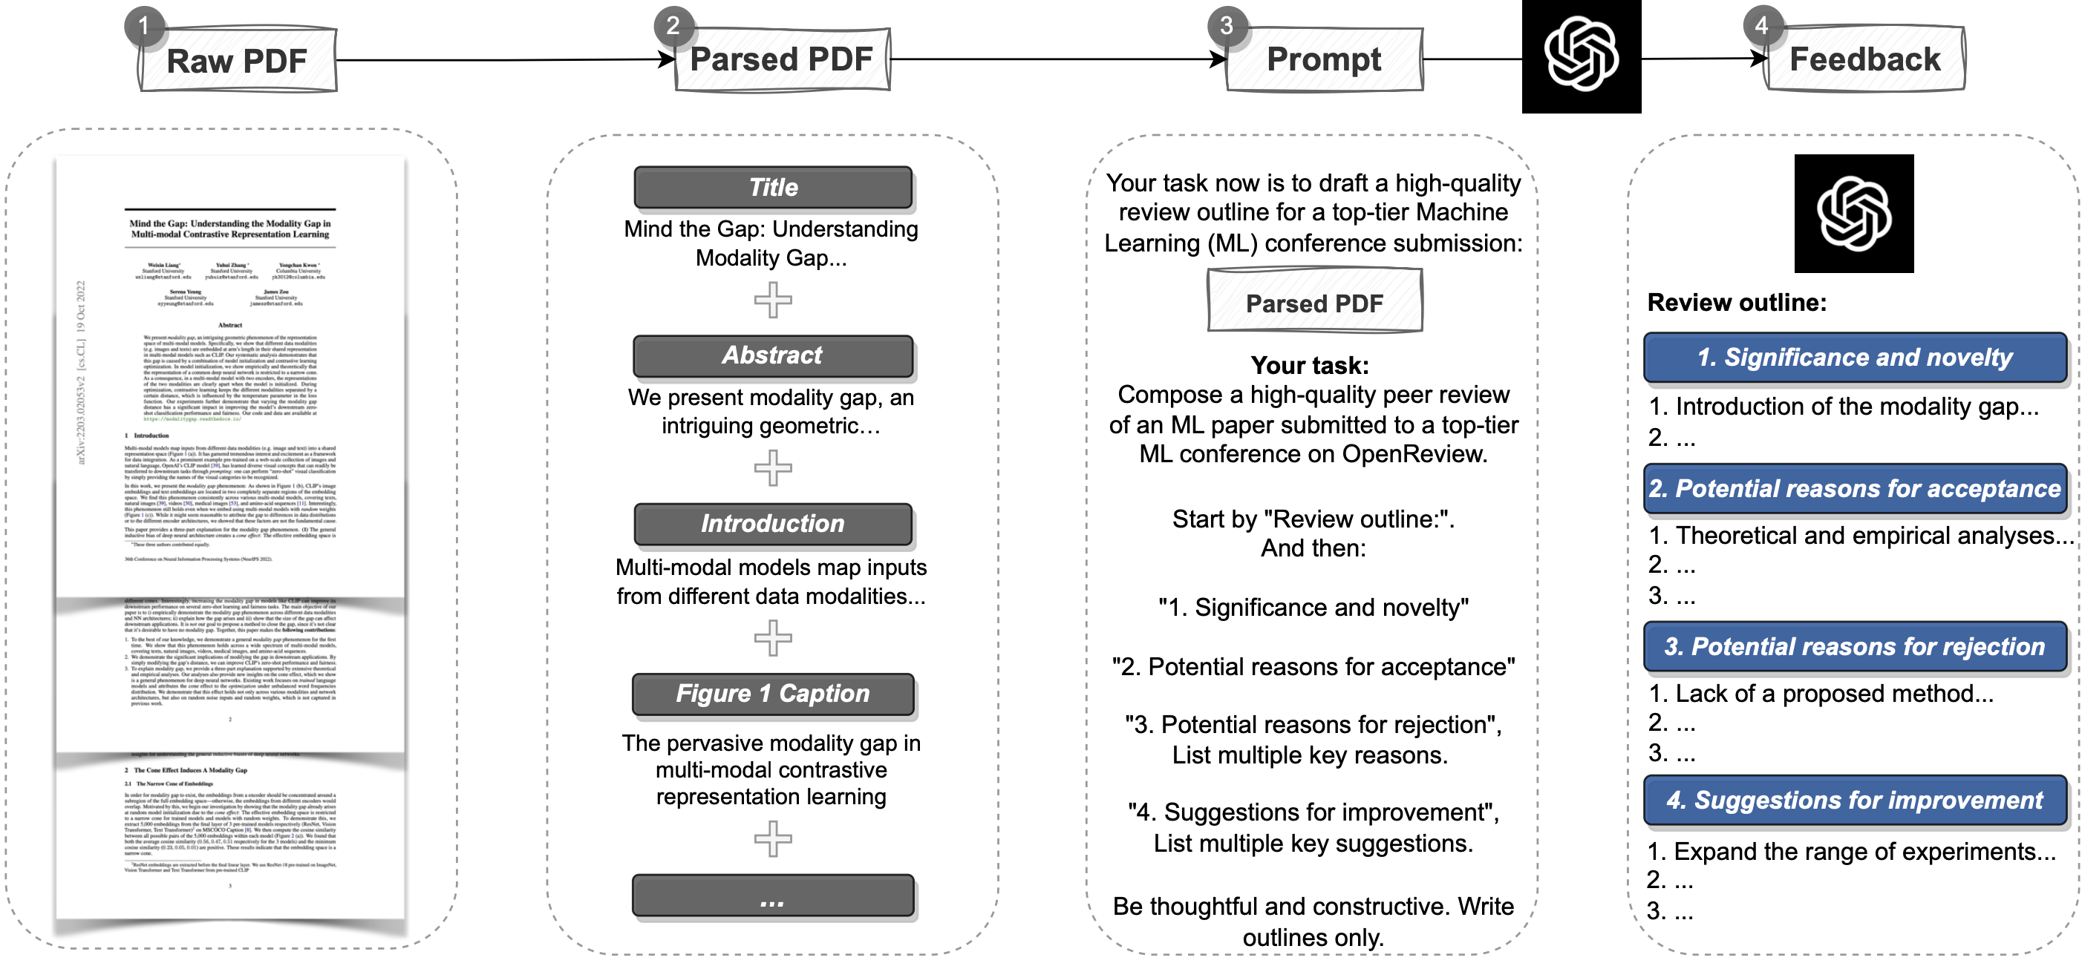
The Angle of our course - Studying LLMs like studying humans
Eg. 1 Evaluate how LLM review papers compared with human reviewers
Source: https://ai.nejm.org/doi/full/10.1056/AIoa2400196
Notes:
Add

Slide 14
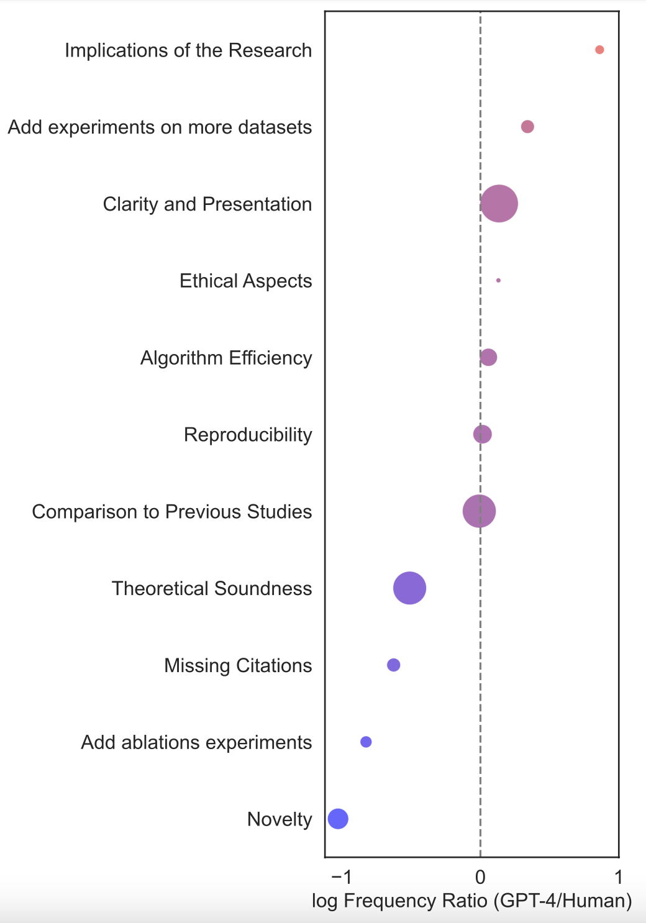
GPT-4 Feedback Emphasizes Certain Aspects more than Humans
LLM comments on implications 7.27x more
LLM comments on novelty 10.69x less
Source: https://ai.nejm.org/doi/full/10.1056/AIoa2400196

Slide 15
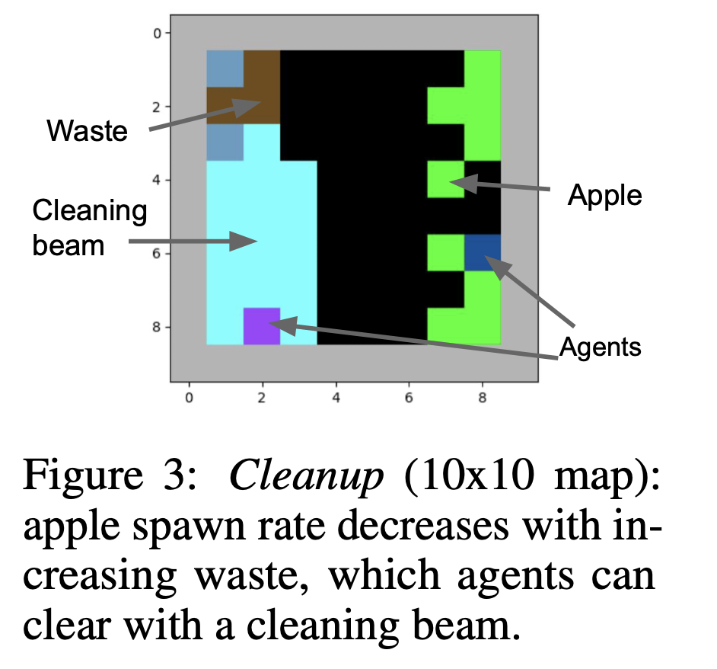
The Angle of our course - Studying LLMs like studying humans
Eg. 2 Measure the social inefficiency of LLM multi-agent systems
Source: https://arxiv.org/abs/2004.07625
Notes:
Society
My research focus on social inefficiency
Video game RL
Economics PD Congestion game PoA
Real situation worse
LLM?

Slide 16
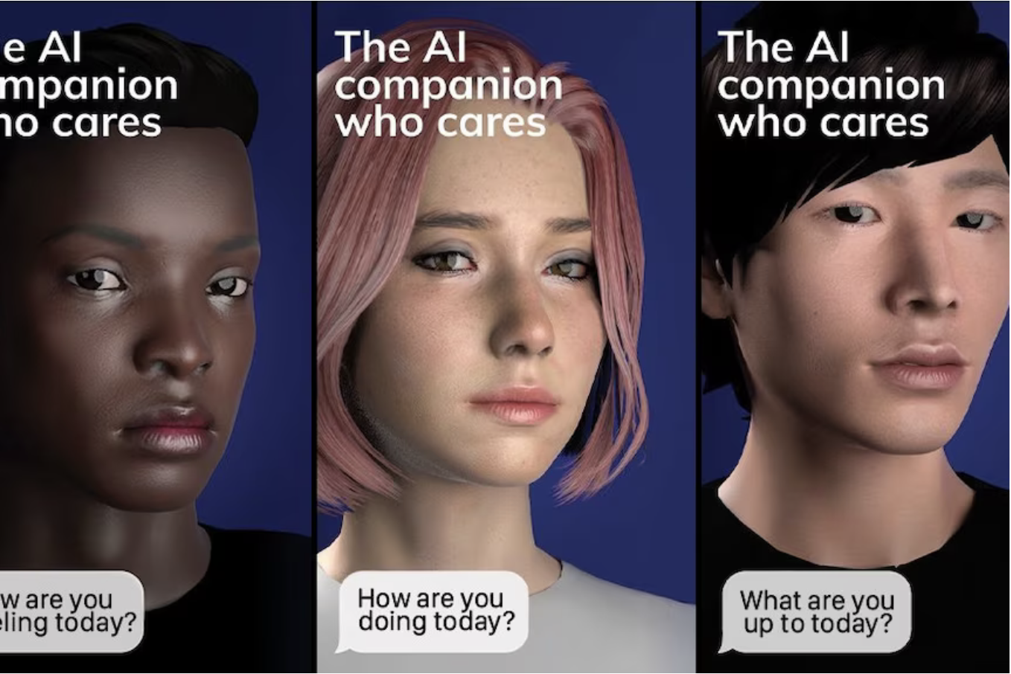
The Angle of our course - Interactions between LLM and society
Eg.1 Human’s reactions to LLMs
Trust / Privacy concerns
Rely / Replacement / Resistance / Co-evolution
Exploitation / Cooperation / Competition
Notes:
Add

Slide 17
The Angle of our course - Interactions between LLM and society
Eg.2 User privacy, data externality and pricing
Human novel input:
Novel knowledge
Coding
Math reasoning
GPT model update
Notes:
Add

Slide 18
The Angle of our course - Interactions between LLM and society
Eg.2 User privacy, data externality and pricing
Human novel input:
Novel knowledge
Coding
Math reasoning
GPT model update
Human Incentives:
Privacy
Profit
Creativity
GPT profit
Notes:
Add

Slide 19
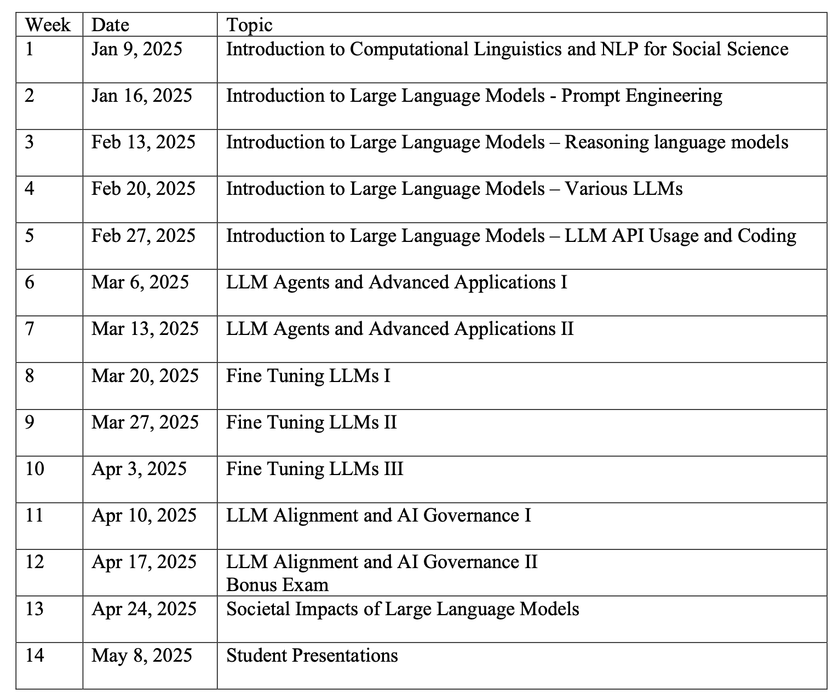
Course Content – LLM Focused

Slide 20
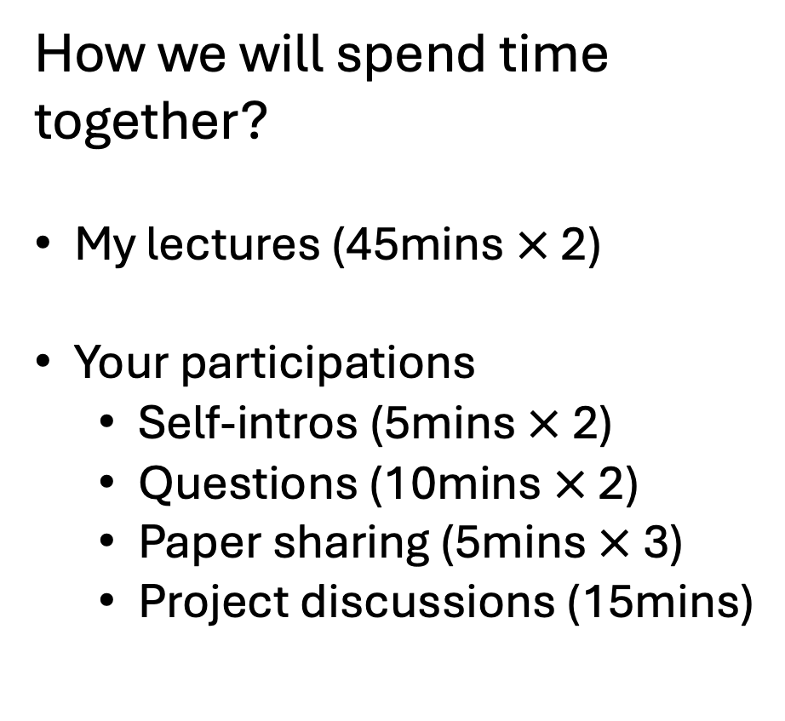
2:00 pm
Class Participation – Self-Intro
2:05 pm
Lecture Part I
How we will spend time together?
My lectures (45mins $×$ 2)
Your participations
Self-intros (5mins $×$ 2)
Questions (10mins $×$ 2)
Paper sharing (5mins $×$ 3)
Project discussions (15mins)
2:50 pm
Class Participation - Questions
3:00 pm
Rest
3:10 pm
Lecture Part II
3:15 pm
Class Participation – Self-Intro
4:00 pm
Class Participation - Questions
4:10 pm
Rest
4:20 pm
Class Participation – Paper Sharing
4:35 pm
Project Related 1 – 1 Discussions
4:50 pm

Slide 21
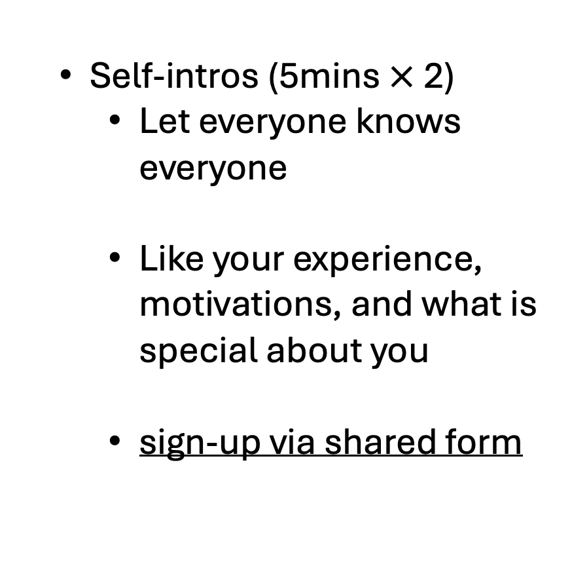
2:00 pm
Class Participation – Self-Intro
2:05 pm
Lecture Part I
Self-intros (5mins $×$ 2)
Let everyone knows everyone
Like your experience, motivations, and what is special about you
sign-up via shared form
2:50 pm
Class Participation - Questions
3:00 pm
Rest
3:10 pm
Lecture Part II
3:15 pm
Class Participation – Self-Intro
4:00 pm
Class Participation - Questions
4:10 pm
Rest
4:20 pm
Class Participation – Paper Sharing
4:35 pm
Project Related 1 – 1 Discussions
4:50 pm

Slide 22
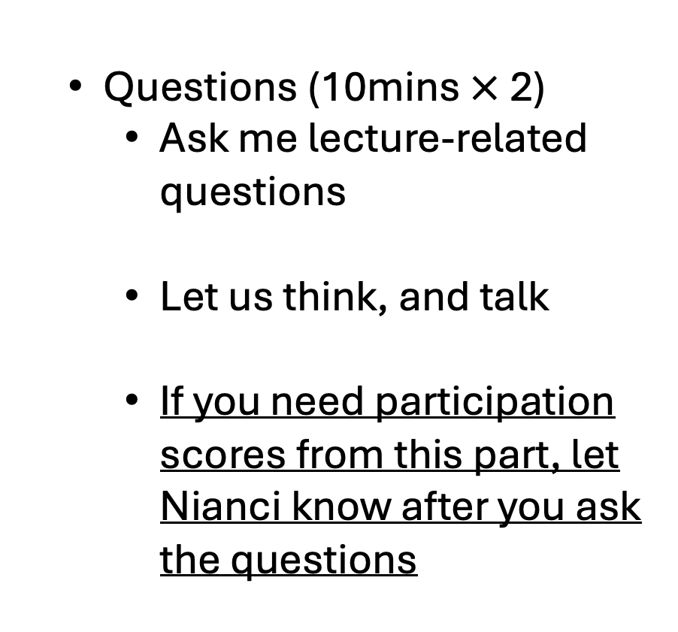
2:00 pm
Class Participation – Self-Intro
2:05 pm
Lecture Part I
Questions (10mins $×$ 2)
Ask me lecture-related questions
Let us think, and talk
If you need participation scores from this part, let Nianci know after you ask the questions
2:50 pm
Class Participation - Questions
3:00 pm
Rest
3:10 pm
Lecture Part II
3:15 pm
Class Participation – Self-Intro
4:00 pm
Class Participation - Questions
4:10 pm
Rest
4:20 pm
Class Participation – Paper Sharing 1
4:35 pm
Project Related 1 – 1 Discussions
4:50 pm

Slide 23
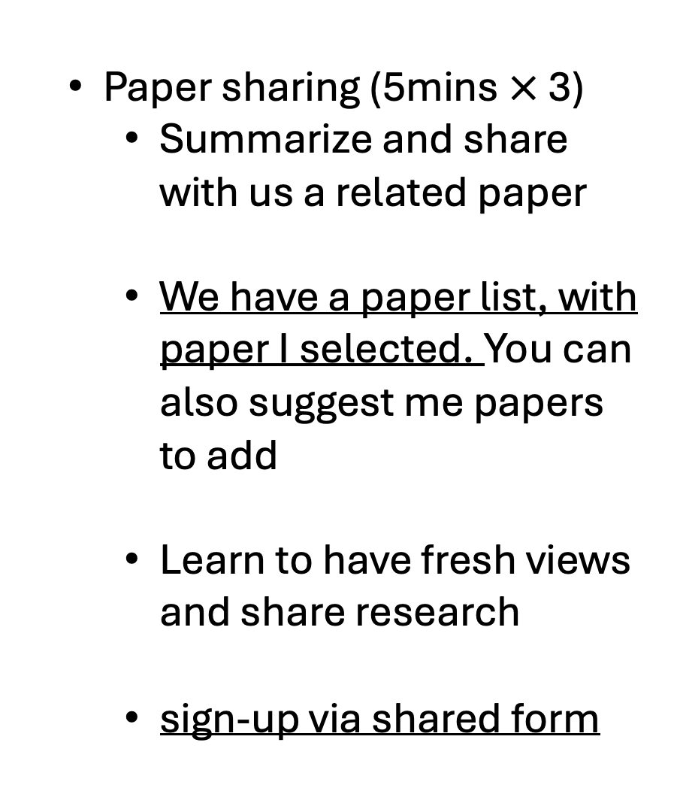
Paper sharing (5mins $×$ 3)
Summarize and share with us a related paper
We have a paper list, with paper I selected. You can also suggest me papers to add
Learn to have fresh views and share research
sign-up via shared form
2:00 pm
Class Participation – Self-Intro
2:05 pm
Lecture Part I
2:50 pm
Class Participation - Questions
3:00 pm
Rest
3:10 pm
Lecture Part II
3:15 pm
Class Participation – Self-Intro
4:00 pm
Class Participation - Questions
4:10 pm
Rest
4:20 pm
Class Participation – Paper Sharing
4:35 pm
Project Related 1 – 1 Discussions
4:50 pm

Slide 24
Project discussions (15 mins)
I will help whoever needed to explore project ideas, follow-up research progress, and offer suggestions to obstacles.
sign-up via shared form
Can be extended to my office hr (right after class, 4:50-5:50 pm)
2:00 pm
Class Participation – Self-Intro
2:05 pm
Lecture Part I
2:50 pm
Class Participation - Questions
3:00 pm
Rest
3:10 pm
Lecture Part II
3:15 pm
Class Participation – Self-Intro
4:00 pm
Class Participation - Questions
4:10 pm
Rest
4:20 pm
Class Participation – Paper Sharing
4:35 pm
Project Related 1 – 1 Discussions
4:50 pm

Slide 25
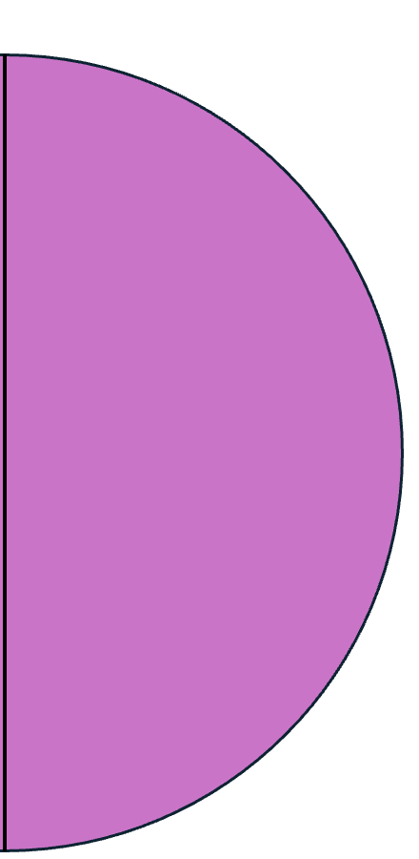
Technical Quiz (take-home exam, 20%)
I create real-world, research-driven tech questions for you
We will have a problem set, and you can decide which ones you want to work on independently in class
Take-home: you can search the web, ask GPT for help, and even work with classmates if you want
20%
Class Participation
50%
Individual Class Project
20%
Technical Quiz (take-home exam)
10%
Literature review and presentation

Slide 26
Literature Review Report and Presentation (10%)
You find a relevant research stream that interests you. Read, summarize, and critique
Hope to inspire and set you up on your own research question to ask out of this research stream
Report required. Recorded presentation required.
20%
Class Participation
50%
Individual Class Project
20%
Technical Quiz (take-home exam)
10%
Literature review and presentation

Slide 27
Individual Class Project (50%)
You ask a research question, use the relevant tools. I can help on the way, including helping you finding valuable questions
Starting the 7th week of class, weekly update on progress is needed. Your effort is evaluated here (30%)
Report required. Final in-class representation required. Your novelty and contribution is assessed here (20%)
20%
Class Participation
50%
Individual Class Project
20%
Technical Quiz (take-home exam)
10%
Literature review and presentation

Slide 28
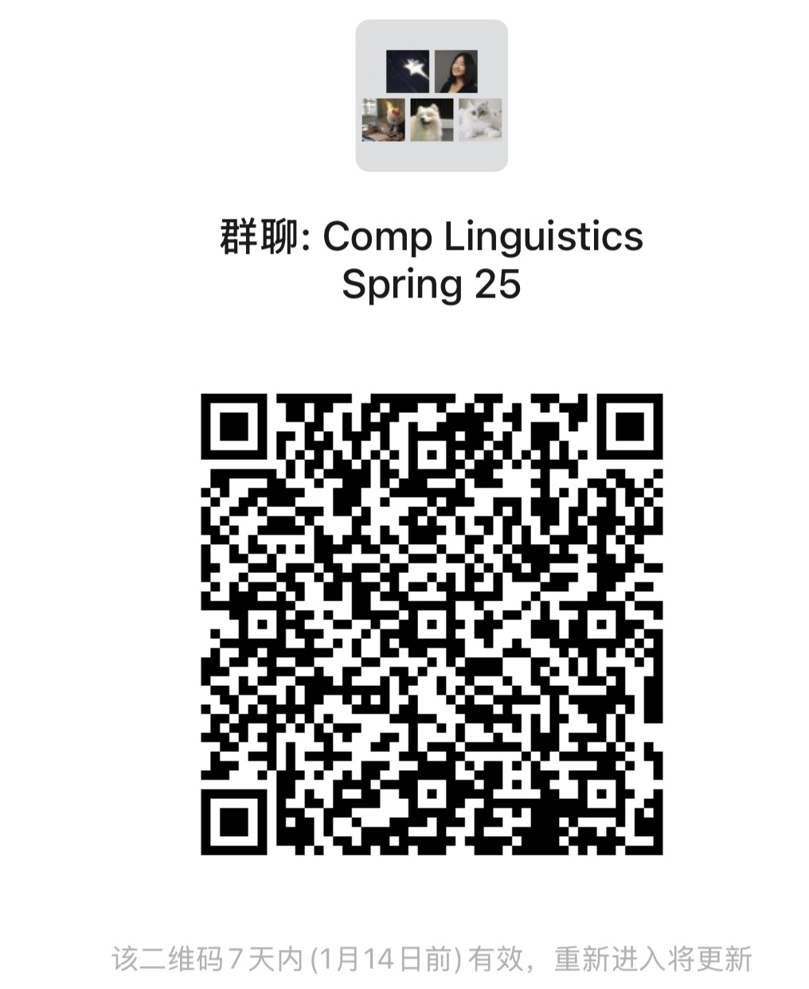
WeChat Group: group chat and sharings
Office hr:
Both TA and me:
After class every week 4:50-5:50pm
Online recordings:
Available, but you need to have an official reason with legal document to access it (like you are sick / job interviews / etc)
Want to register but no seats:
Reach me after class or leave a message before the end of the 2nd week

Slide 29
Questions?
(10mins)

Slide 30
10-mins Break
Lecture 2:
My intro
Students’ intro

Slide 31

Understanding and Mitigating Bias in Algorithms, Data and Society
Zhanzhan Zhao
Notes:
Welcome
Hello everyone. Today I am presenting my thesis work on understanding and mitigating bias in algorithms, data and society. I would like to thank my committee members for their help along my Ph.D. journey.

Slide 32
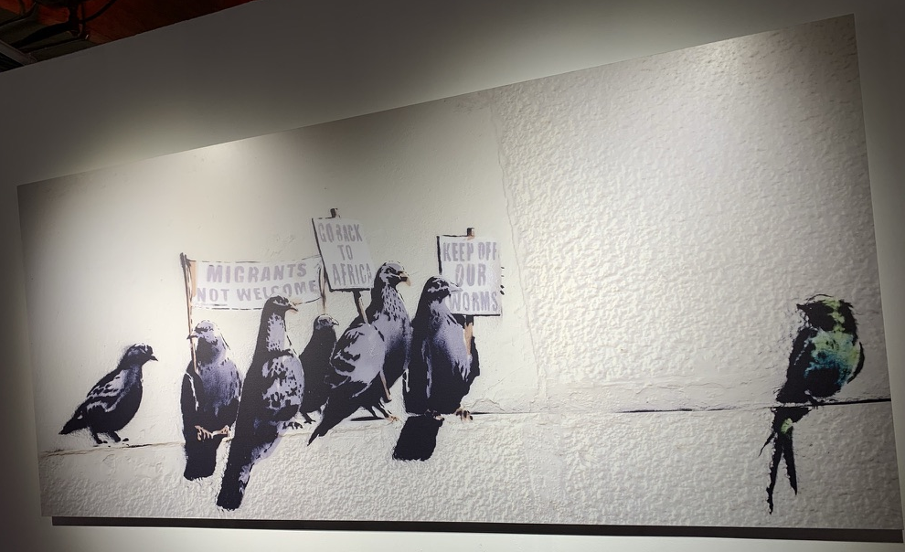
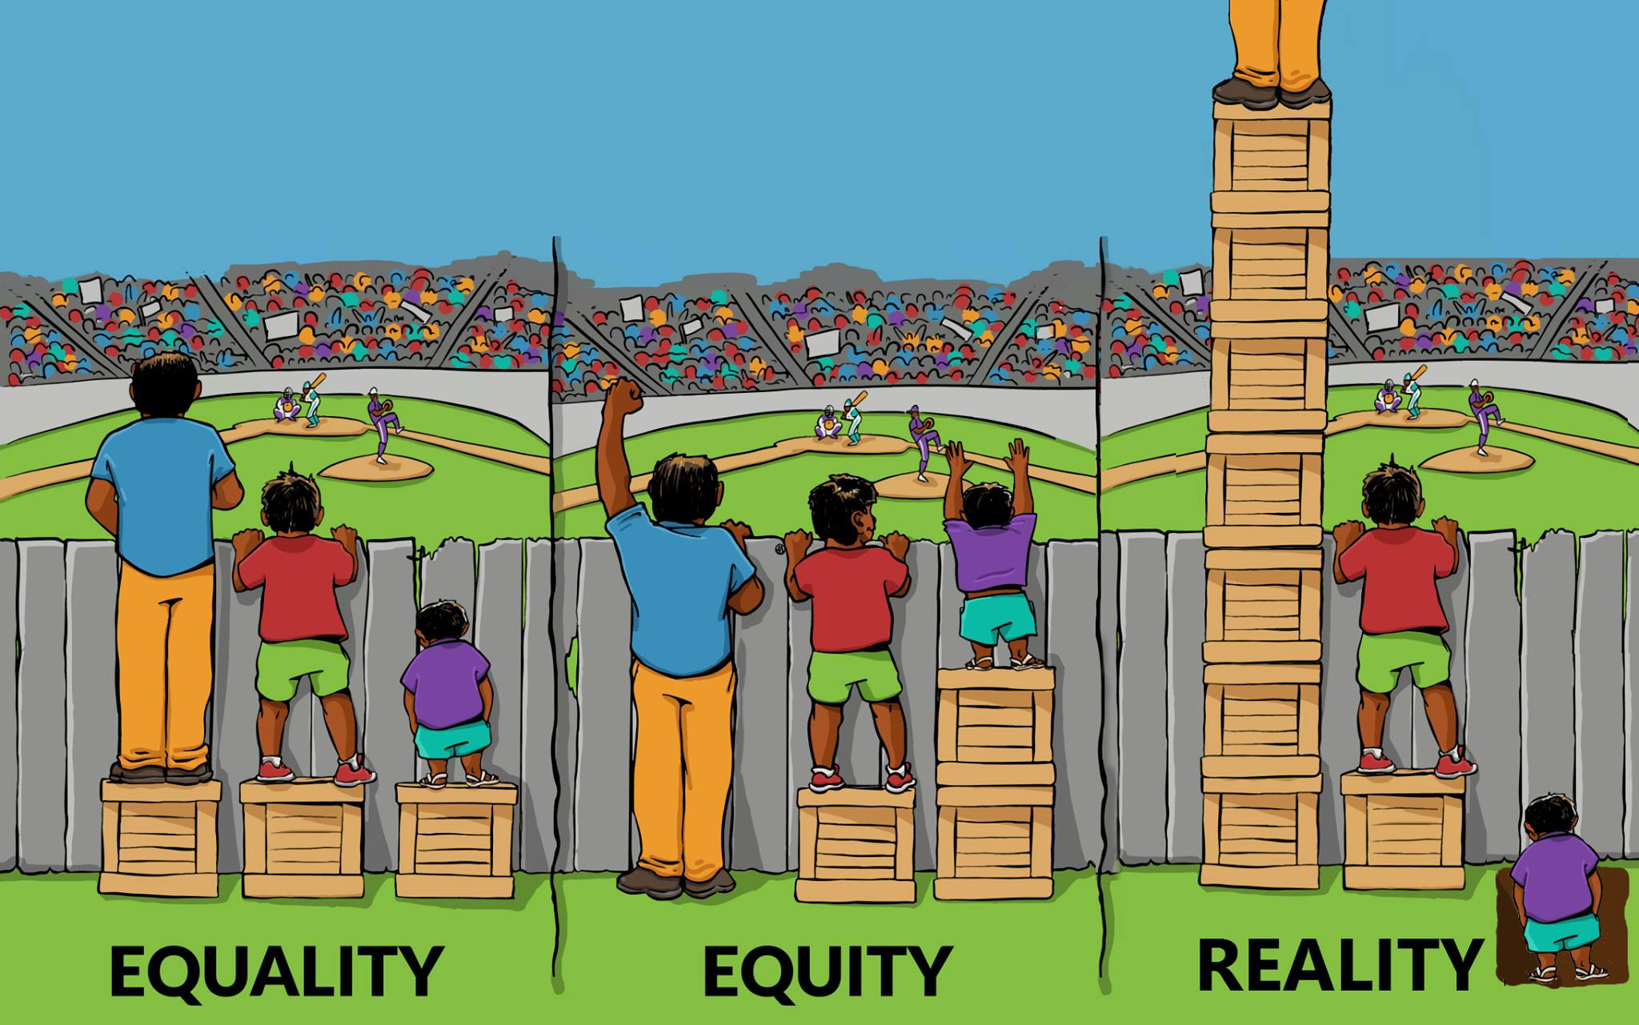
Societal Biases
Impact of Biases
Notes:
Societal biases are ingrained prejudices, such as those based on race, ideology, and partisanship. One of the fundamental reasons why societal biases are detrimental lies in perpetuation and reinforcement of inequality. Moreover, these biases fuel social divisions and undermine social cohesion. Recognizing the importance of mitigating biases is paramount for the advancement of a fair and equitable society.

Slide 33
Role of Computer Science
Contributions: Identifying and correcting algorithmic biases that find applications in various domains, such as:
Healthcare
Recruitment and Hiring
Criminal Justice
Limitation: lack of systemic view
Society:
Black box with limited output
? Long-term influence
?Adjusting designs
Notes:
Tackling societal biases is a multifaceted challenge that demands cross-disciplinary collaboration.
Computer scientists have been contributing to this goal by …
However, we still face substantial obstacles in this field, due to the lack of more systemic view or approach. The society is like a big black box with limited output. As computer scientists meticulously engineer intricate algorithms and applications that find their use in society, we often lack foresight into the potential long-term societal implications. In parallel, we don't have enough feedback data from social trajectories to help us make improvements in designs for the collective good.

Slide 34

Role of Social Sciences
Contributions: understanding root causes and influencing public policies
Limitation: sometimes less rigorous
Society:
Black box with limited output
Complex social dynamics
Data sparsity
Local interaction
System-level policies
Emergence
Notes:
When we step back and look at more than just computer science, we appreciate social scientists’ approaches, which are better at understanding root causes at the system-level, by using qualitative and quantitative methods.
Despite social scientists’ more systemic approach, understanding societal behaviors accurately and rigorously remains challenging. Because of the complexity of social dynamics and limited data, even the most advanced algorithmic and data analysis tools encounter intrinsic limitations here. Human interactions are unpredictable and diverse. Our ability to model these interactions can become increasingly complicated when we factor in system-level policies. Often these policies also carry hidden biases that can significantly influence individuals, further muddying the waters. Further adding to this complexity is the phenomenon known as emergence, which means seemingly insignificant local changes trigger large, unexpected global patterns. Finally, we have data sparsity issues, since gathering information, particularly on biases that people may not be conscious of or willing to disclose, is both time-consuming and often unrewarding.

Slide 35
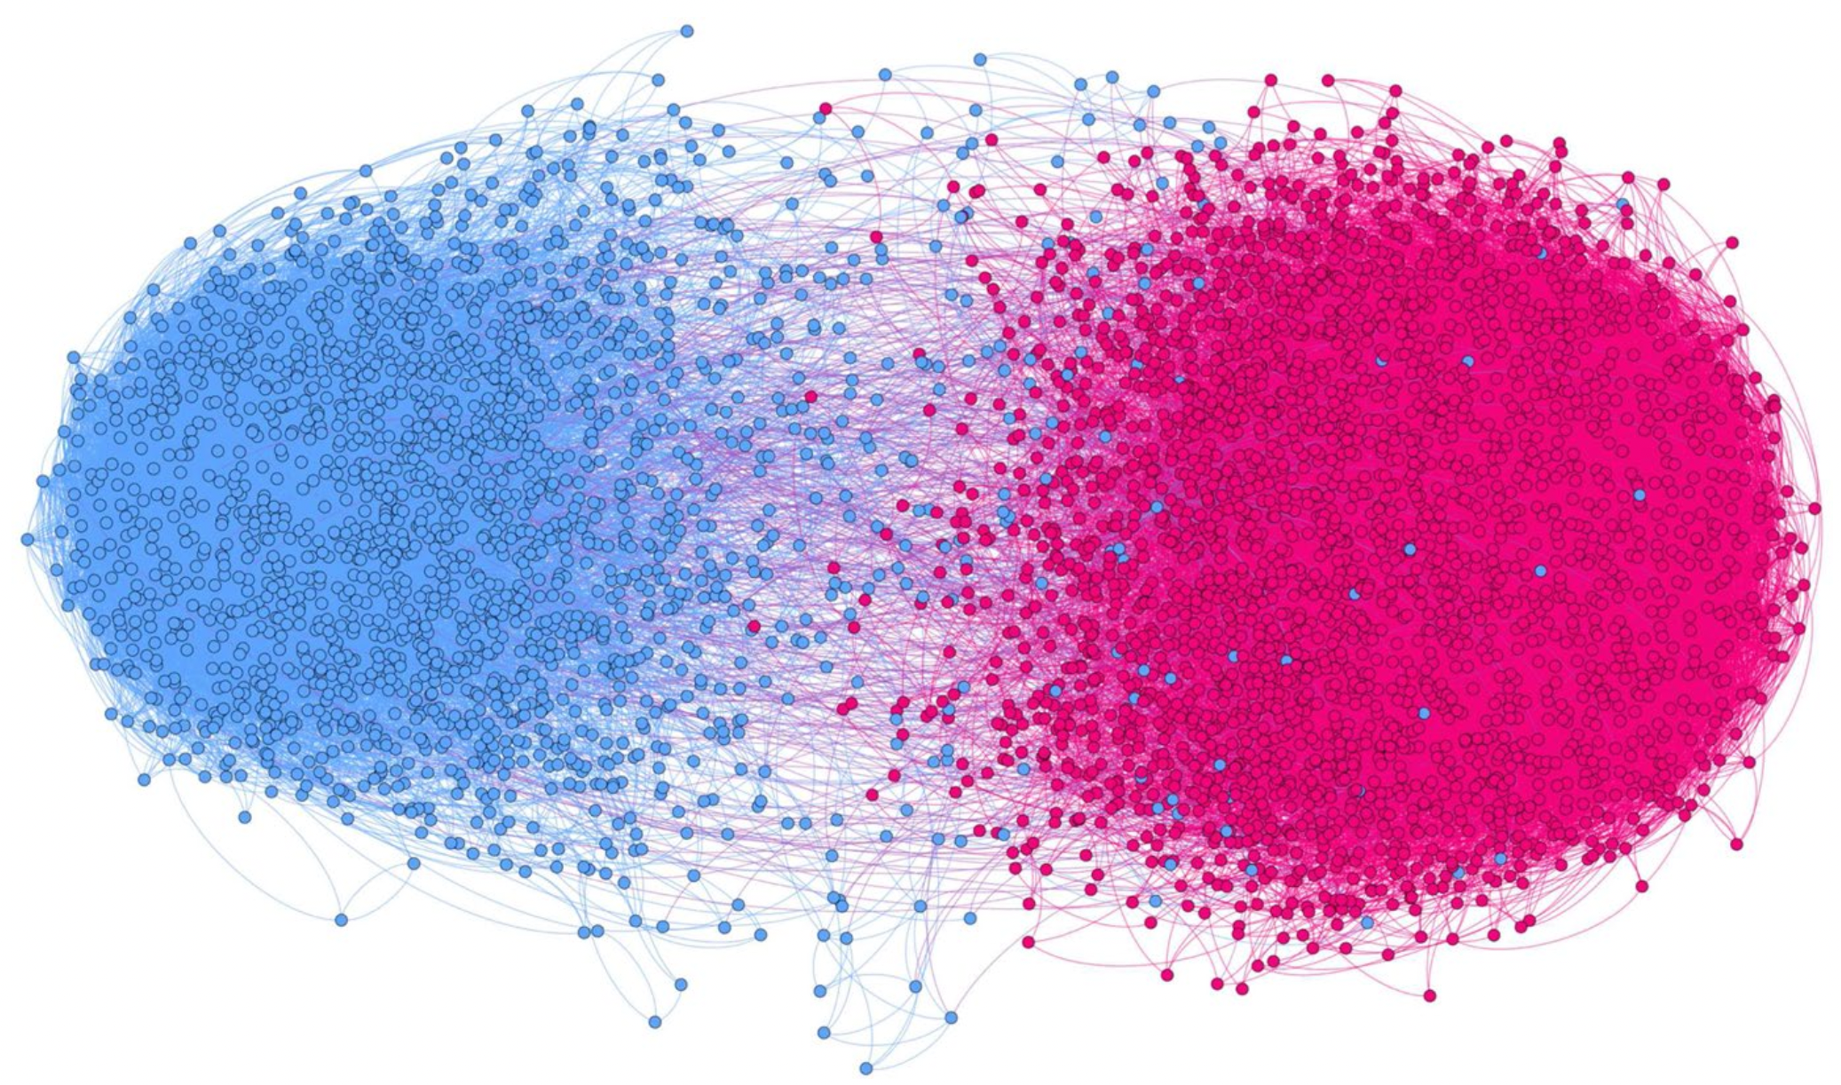
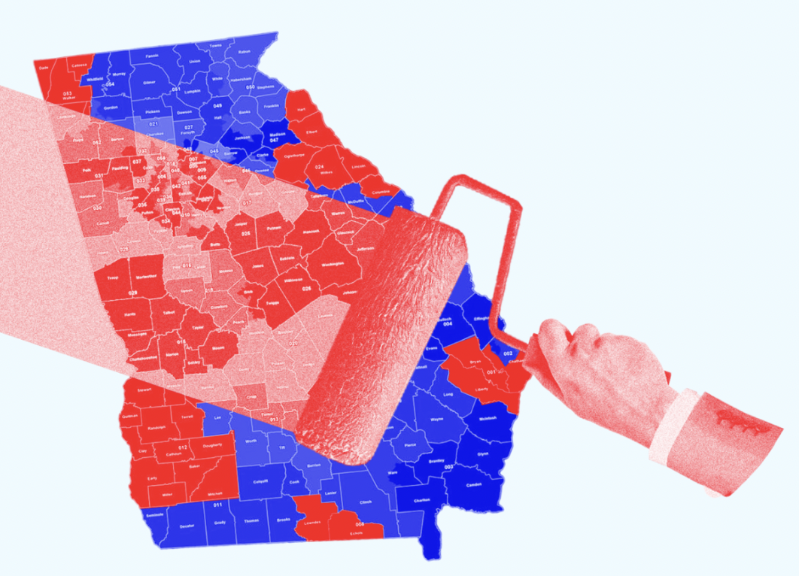
Goal: Study Societal Biases More Rigorously
Theme 1: Racial Segregation
Theme 2: Ideological Polarization
Theme 3: Gerrymandering
Notes:
In the face of these challenges, we develop new algorithms and data analytical tools for identifying and addressing societal biases. We consider three more concrete problems with biases, including the persistent residential, partisan polarization, and ideological polarization. These are all unfortunate social divisions bred by local biases. For each theme, we study how system-level policies might make a difference.

Slide 36
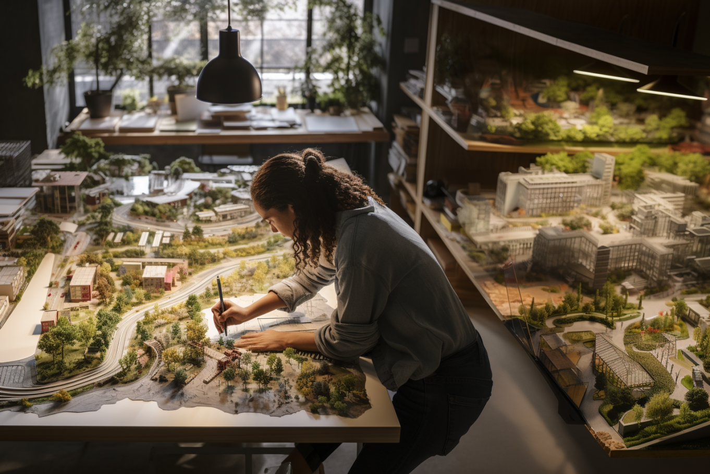
Theme 1: Racial Segregation and Public Amenities
Influence?
Correlations?
Public Amenities
Racial Segregation
Possible mechanisms
Markov chain analysis
Complex emergent phenomenon
Z. Zhao and D. Randall. A heterogeneous Schelling model for wealth disparity and its effect on segregation. In Equity and Access in Algorithms, Mechanisms, and Optimization (EAAMO). ACM, 2022.
Z. Zhao, C. Yoo, N. Golshani, C. Ross, and D. Randall. National and regional correlations between public amenities and racial segregation in U.S. cities. in preparation, 2023.
Notes:
When urban planners sketch transit routes or plan street gardens, the potential impacts of these designs on segregation are usually not considered. Here, we are going to show you rigorously how public amenities might make a difference to segregation through Markov chain analysis.

Slide 37
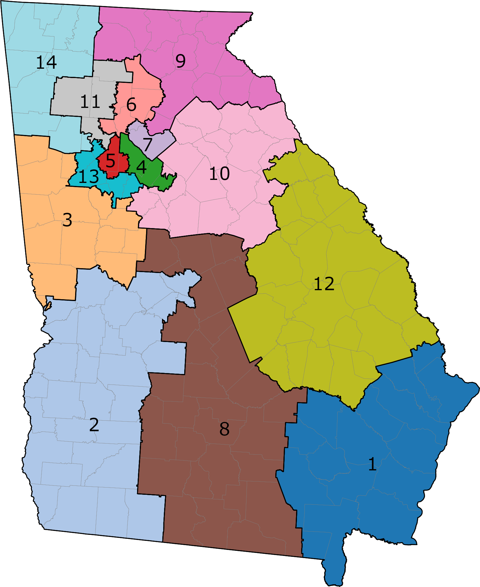
Theme 2: Partisan Polarization and Redistricting
Influence?
Redistricting policy
Partisan Polarization
Auditing
Algorithms and data analysis
Public policies
Bring clarity
Notes:
This innovative approach highlights the instrumental role of algorithms and data analysis in auditing and bringing clarity to public policies.

Slide 38
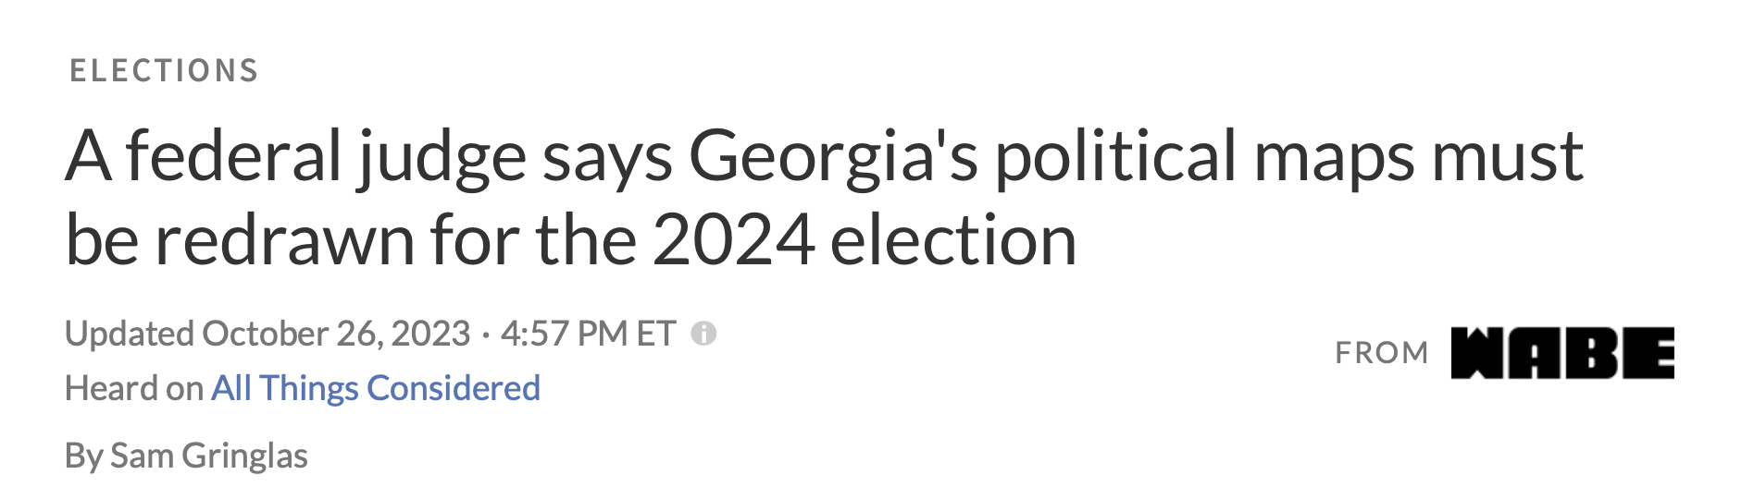
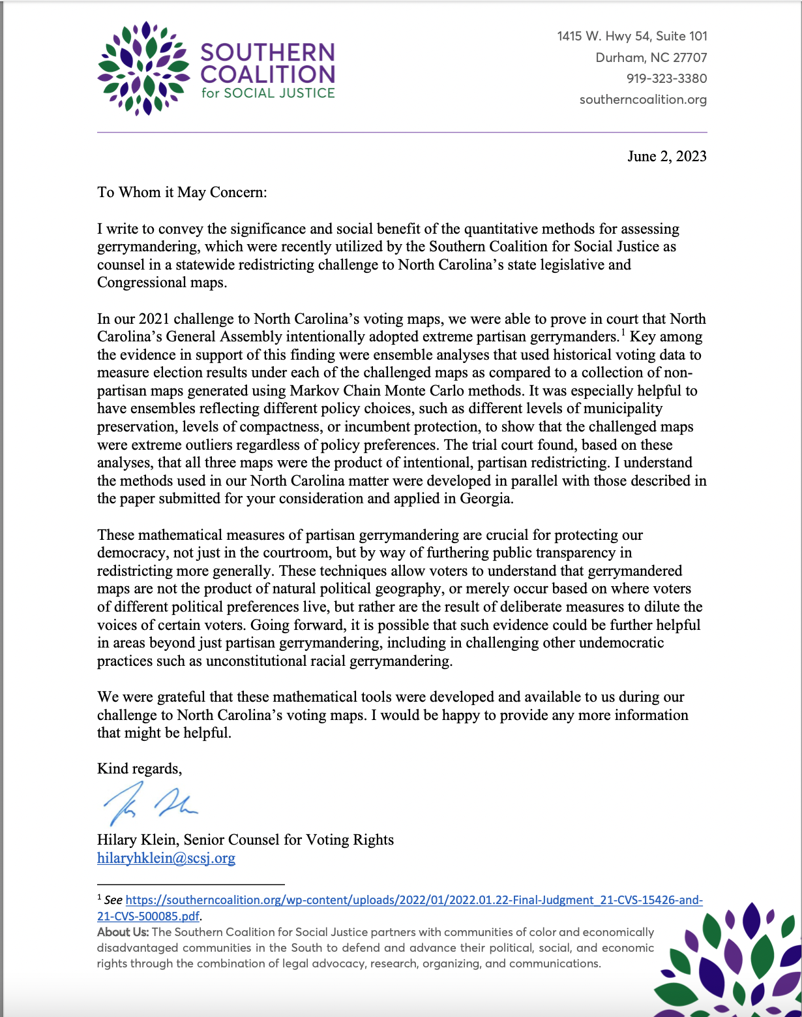
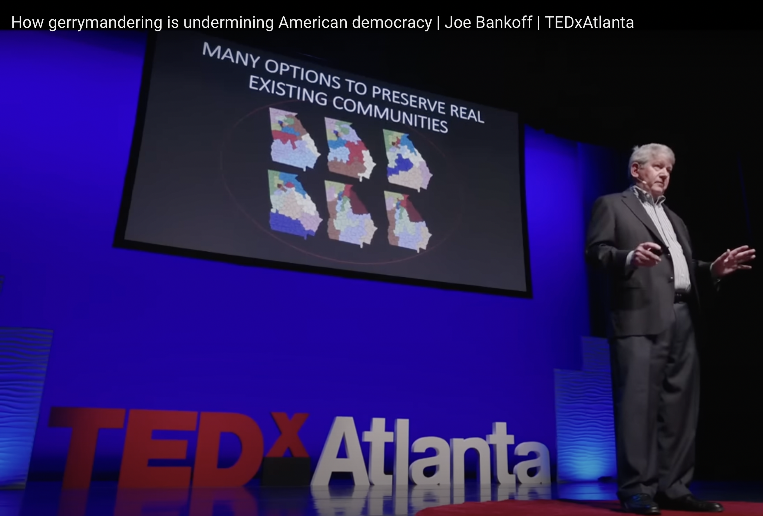

Slide 39
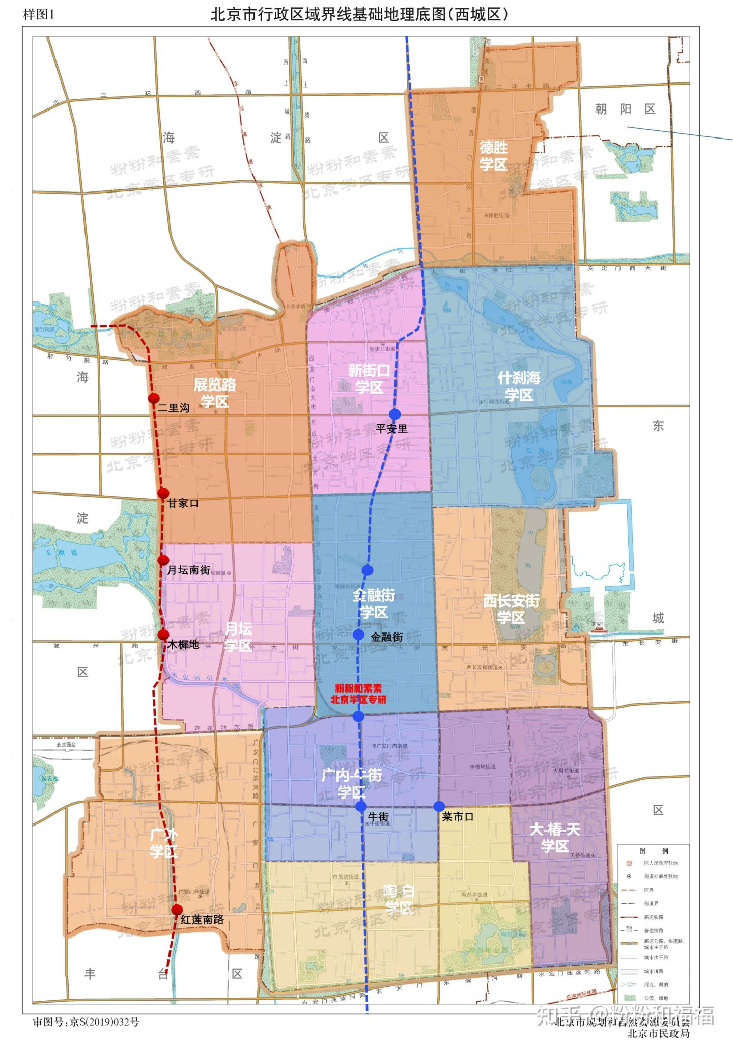
The Equitable School Districting in China
Are the current school districts fair to people from different economic classes?
How can school districts be drawn to ensure fairness across all social classes?
How can school district policies counteract localized self-interest to achieve broader societal equity?

Slide 40
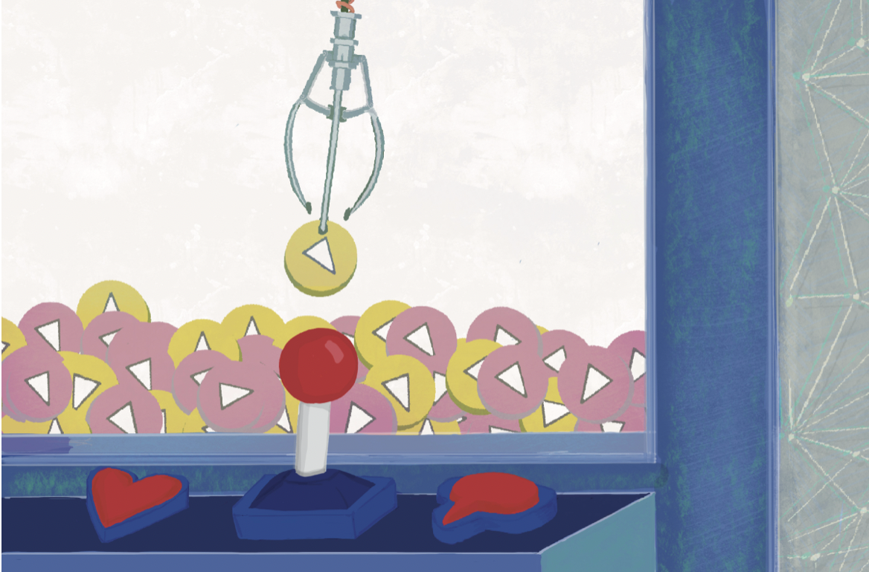
Theme 3: Ideological Polarization and Recommendations
Influence?
Recommendation Designs
A Polarized Online Network
bridge
Careful treatment of diversity
Ideological divides
Z. Zhao and D. Randall. “Mitigating Extreme Political Attitudes through Novel Online Recommendation Designs.” In preparation.
Possible applications and verifications in healthcare
Notes:
Second, let's turn our attention to ideological polarization. We explore how personalized recommender algorithms can contribute to extreme polarization through agent-based modeling. Our simulations highlight the effectiveness of novel recommendation designs in reversing polarization, even in the presence of extreme influencers and the spiral of silence effect, in the words, individuals’ social pressure. We emphasize the importance of tailored interventions that leverage diversity to foster inclusive dialogue and bridge ideological divides.

Slide 41
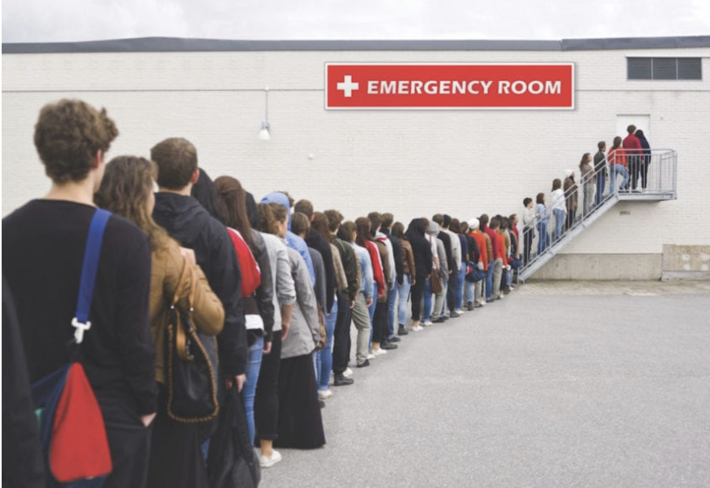

Theme 4 : Patient Admission and Epidemic Spreading
Influence?
Adjust?
Patient Risk Prediction
Epidemic Spreading
Social-welfare-aware machine learning algorithm
Mitigate
Health crisis
Notes:
When urban planners sketch transit routes or plan street gardens, the potential impacts of these designs on segregation are usually not considered. Here, we are going to show you rigorously how public amenities might make a difference to segregation through Markov chain analysis.

Slide 42
Join us as a Research Assistant!
What You Will Receive:
Access and support to computing resources
More frequent communication within our research team (also more pressure)
Potential for research publications (sometimes coauthorship)
The possibility of a part-time contract with a salary.
Strong recommendation letters
What We Expect From You:
A commitment of at least 15 hours per week for full-time engagement
Programming skills
If you find this opportunity intriguing, please reach out to me for further details.
zhanzhanzhao@cuhk.edu.cn

Slide 43
No paper sharing for today
Project Discussion part:
stay if you want to chat about anything
Office hr (me and Nianci)

